Slide 1
WorldVisitz Mobile Application Agile Delivery Launch
Agile Foundations - Presentation for the Leadership Team
Presented by: Salma Attia
© 2019 Udacity. All rights reserved.

Slide 2
Part 1: How WorldVisitz Can Benefit From Agile

Slide 3


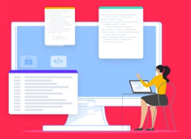
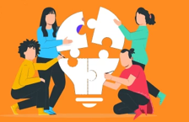

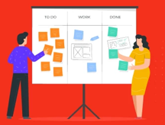


What is Agile?
Agile is a mindset and methodology focused on iterative development, customer collaboration, and responsiveness to change. It is the ability to create and respond to change. It is a way of dealing with, and ultimately succeeding in, an uncertain and turbulent environment.
(a) Individuals and interactions
(b) Responding to change
(c) Working software over
(d) Customer collaboration
over
over
over
over
processes and tools
following a plan
comprehensive documentation
contract negotiation
Notes:
Good morning gentlemen; this is Salma Attia, certified Agile Coach from Ejada. Today, I am explaining what agile is and how it will benefit WorldVisitz.
I believe you're asking yourself; What is agile? in project management Agile is an iterative project management and software development approach that helps teams deliver value to customers faster and with fewer mistakes. So Instead of betting everything on a significant launch, an agile team provides work in small but consumable increments.
It has four central values. We call them the agile manifesto: Individuals and interactions over processes and tools, Working software over comprehensive documentation, Customer collaboration over contract negotiation, and finally, Responding to change over following a plan.

Slide 4
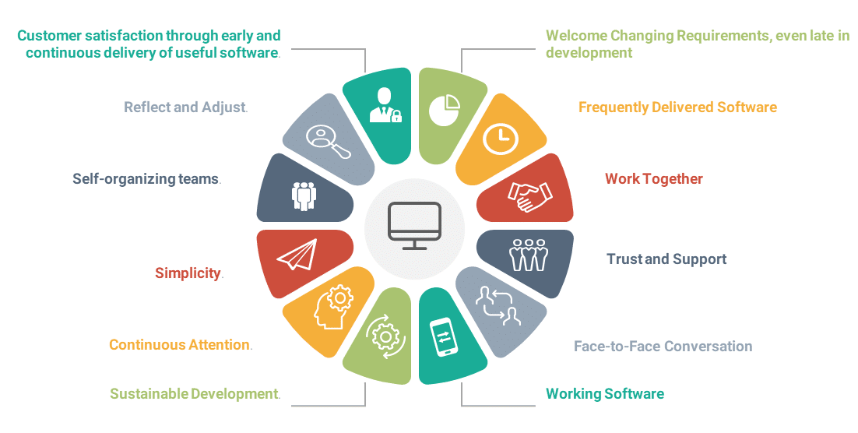
What is Agile manifesto?
The Agile Manifesto is a document that identifies four key values and 12 principles that its authors believe software developers should use to guide their work. Formally called the Manifesto for Agile Software Development, it was produced by 17 developers during an outing on Feb. 11-13, 2001, at The Lodge at Snowbird ski resort in Utah.
Agile project management brings together Agile teams of programmers, stakeholders and users to support Agile principles. Team members conduct face-to-face conversations, both in person and remotely, and they communicate regularly as part of the primary measure of progress. This approach supports the key aspect of the Agile process -- developing software in increments with user input along the way, as opposed to a final product with minimal user interaction.
Notes:
Agile project management is unique because it focuses on delivering quality and value to customers while completing the project within the given timeline.
It makes the managers' jobs easier and gives them greater control over their projects.
Agile has many advantages; I summarized them in 4 points :
Predictability: with increased visibility, the PM can oversee performance and develop timely mitigation plans if necessary.
Reduced risk: since agile is all about working in iterations or sprints, this means that the team is entirely focused on delivering that sprint which reduces possible risks
Improved quality: in agile, tesing is a critical part activated at each sprint, and the client is involved in the whole process. With that, the team will be able to deliver the best solution that matches the customer's needs with the best value.
Better communication: Agile promotes regular meetings with team members, customers, sponsors, and any concerned party. Doing this will remove any unclarity between parties and eventually help the agile team achieves success.

Slide 5
What is Agile manifesto?
Principle | Description | Principle | Description
1. Customer Satisfaction 🕒 | Early and continuous delivery of valuable software | 7. Working Software ✅ | Primary measure of progress is working software
2. Embrace Change 🔄 | Welcome changing requirements even late in development | 8. Sustainable Pace ⚖️ | Agile promotes sustainable development pace
3. Frequent Delivery 📦 | Deliver working software frequently | 9. Technical Excellence 🧠 | Enhance agility through good design
4. Collaboration 👥 | Business and developers work together daily | 10. Simplicity ✂️ | Maximize work not done
5. Empowered Teams 💪 | Build around motivated individuals | 11. Self-Organization 🧩 | Best designs emerge from self-organizing teams
6. Face-to-Face 🗣 | Best communication via face-to-face conversation | 12. Reflection & Adaptation 🔁 | Regularly reflect and adjust behavior
Notes:
It is built on 12 principles that are designd to help companies and teams are prioritizing the core of being agile“Customers, working software, collaboration, responding to change.
here are the 12 principles :
Our highest priority is to satisfy the customer through early and continuous delivery of valuable software.
Welcome changing requirements, even late in development. Agile processes harness change for the customer’s competitive advantage.
Deliver working software frequently, from a couple of weeks to a couple of months, with a preference to the shorter timescale.
Business people and developers must work together daily throughout the project.
Build projects around motivated individuals. Give them the environment and support they need, and trust them to get the job done.
The most efficient and effective method of conveying information to and within a development team is face-to-face conversation.
Working software is the primary measure of progress.
Agile processes promote sustainable development. The sponsors, developers, and users should be able to maintain a constant pace indefinitely.
Continuous attention to technical excellence and good design enhances agility.
Simplicity–the art of maximizing the amount of work not done–is essential.
The best architectures, requirements, and designs emerge from self-organizing teams.
At regular intervals, the team reflects on how to become more effective, then tunes and adjusts its behavior accordingly.

Slide 6
Key differences between Agile and Waterfall
Feature | Agile | Waterfall
Development Style | Iterative & Incremental | Linear & Sequential
Flexibility | Highly adaptable to changes | Rigid, changes are hard to implement
Customer Involvement | Continuous feedback and collaboration | Only at start and end
Delivery | Early and continuous | Final delivery only
Planning | Progressive during sprints | Detailed upfront
Testing | Continuous, within sprints | After development ends
Documentation | Lightweight | Comprehensive
Risk Mitigation | Handled early with iterations | Discovered late
Success Metrics | Working software & satisfaction | Scope & deadline adherence
Team Structure | Cross-functional, self-organized | Siloed & hierarchical
Notes:
The waterfall approach is maybe the most well-known methodology in project management. It follows a linear process where each task must be completed before moving on to the next. This methodology has proven its excellence. However, it would not work in a fast-paced software development environment, where clients regularly change their minds and insist on new deliverables.
On the other hand, Agile was developed as a response to Waterfall’s linear structure. To act as a flexible method that welcomes incorporating changes of direction even late in the process and accounting for stakeholders’ feedback throughout the process.

Slide 7
The benefits of Business Agility to WorldVisitz
(i) why Agile is a more effective solution for WorldVisitz
Reason | Details
1. Delivers Business Value Sooner | Agile allows WorldVisitz to launch core features like flight booking and payment much earlier than Waterfall. This incremental delivery approach accelerates monetization and captures early market share.
2. Adapts to Change Quickly | In the dynamic travel industry, Agile enables continuous response to customer needs and competitive trends—critical for optimizing upselling strategies and integrations with partners (e.g., HotelzMotelz, AutoRentalz).
3. Breaks Down Team Silos | Agile promotes cross-functional teams and daily collaboration—addressing the current disconnect between project management, offshore/onshore developers, QA, and SMEs.
4. Encourages Continuous Improvement | Through retrospectives and feedback loops, Agile helps resolve the issues of weak coding standards, poor knowledge sharing, and late-stage testing currently plaguing the team.
Notes:
Business agility means WorldVisitz can respond to change instead of resisting it—this is crucial when launching a digital product in the fast-moving travel tech space. With Agile, they’ll see working results in weeks, not months, and gain the flexibility to adjust based on customer behavior and market trends.

Slide 8
The benefits of Business Agility to WorldVisitz
(ii) incorporate at least two Agile principles
Principle #1 – Early and Continuous Delivery“Our highest priority is to satisfy the customer through early and continuous delivery of valuable software.”WorldVisitz will see working versions of the product every 2–3 weeks, allowing faster go-to-market.
Principle #12 – Reflect and Adjust Regularly“At regular intervals, the team reflects on how to become more effective, then tunes and adjusts its behavior accordingly.”This helps address gaps in team alignment, testing timing, and communication between distributed teams.

Slide 9
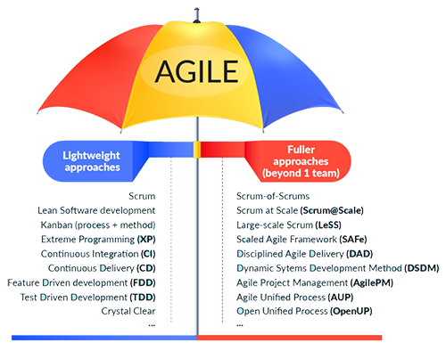
What is Agile Umbrella
The Agile Umbrella refers to a collection of methodologies that align with Agile values and principles, offering different approaches to iterative and incremental software delivery. These include Scrum, Kanban, XP, and others—each adaptable based on the nature of work, team maturity, and project complexity.
Notes:
“Agile” is an umbrella term for all the methodologies that follow the values and principles in the Agile Manifesto. Organizations can be agile using any of the available Agile Frameworks described below.
Scrum is an Agile framework that uses set processes and protocols, including sprints, to enhance collaboration and continuously improve upon problems.
Extreme Programing An agile software development framework that seeks to produce high-quality software, and a higher quality of life for the development team
a Kanban board is a visual representation of a workflow. Kanban cards - tasks - will move through various process stages right towards completion.

Slide 10
What is Agile Umbrella
Comparison of Scrum, Kanban, and XP
Feature | Scrum | Kanban | Extreme Programming (XP)
Structure | Iteration-based (Sprints, 1–4 weeks) | Flow-based (continuous delivery) | Iteration-based with engineering emphasis
Key Focus | Roles, ceremonies, incremental value | Workflow visualization & efficiency | Technical practices and developer discipline
Roles | PO, Scrum Master, Development Team | No fixed roles | Similar to Scrum + emphasis on dev roles
Planning | Sprint Planning, Backlog refinement | Continuous flow and priority adjustment | User stories, iteration planning
Work in Progress | Controlled via sprint commitments | WIP limits per column | Controlled through pair programming & TDD
Meetings | Daily Scrum, Review, Retrospective | Standups, review as needed | Standups, Pair check-ins, Retrospective
Technical Practices | Optional (recommended via DoD) | Not prescribed | Required (TDD, CI/CD, Refactoring, Pairing)
Best Use Cases | Cross-functional teams delivering features | Support & maintenance teams | High-change, high-risk, mission-critical systems

Slide 11
Part 2: The Optimal Agile Framework for WorldVisitz

Slide 12
Recommendations and justifications for WorldVisitz
Overview of Agile Frameworks
Framework | Key Features | Best Fit | Limitations
Scrum | Time-boxed sprints, defined roles, structured ceremonies, focus on team delivery | Teams delivering new features with customer involvement | Requires role clarity and strong facilitation
Kanban | Visualize workflow, manage WIP, optimize flow, no mandatory roles or ceremonies | Maintenance/support teams or when priorities shift frequently | Less prescriptive, slower cultural shift
XP (Extreme Programming) | TDD, pair programming, continuous integration, frequent releases, simplicity | Technically demanding projects needing high code quality | Requires discipline and technical maturity

Slide 13
Recommendations and justifications for WorldVisitz
Three Business Challenges at WorldVisitz
Long Delivery Timeline (18+ months)
Impact: Delays time-to-market, ROI, and user feedback
Solution: Scrum enables iterative releases every 2–3 weeks. Early launch of critical features (e.g., flight booking) is possible.
2. Poor Knowledge Transfer & Siloed Teams
Impact: Offshore/onshore devs don’t share learnings; SME and BA interactions are isolated
Solution: Scrum encourages cross-functional collaboration through daily standups and sprint reviews; XP promotes pair programming and shared ownership.
3. Lack of Coding Standards and Late Testing
Impact: Defects discovered late; inconsistent quality across modules
Solution: XP enforces Test-Driven Development (TDD), continuous integration, and coding standards—ensuring high-quality, maintainable code.

Slide 14
Recommendations and justifications for WorldVisitz
Recommended Framework for WorldVisitz: Scrum + XP Hybrid
Justification | How It Helps
Scrum provides structure and visibility | Enables iterative planning, stakeholder demos, and team alignment across geographies
XP ensures technical excellence | Addresses coding standards, testing early, and frequent releases
Combination tackles both process and code quality issues | Drives product delivery speed and code sustainability

